Slide 1
Final Project
The Data Analyst Job Hunt

Slide 2
Team
James Harkin
Sharona Jones
Matthew Rodenberg
Aswitha Bachala
Viviane Chery-Webster

Slide 3
Topic
Our goal is to determine the best place for a new data analyst to work.
Our subject is willing to travel anywhere, and is only concerned with the economics of that location.
Variables include: cost of living, median household income, unemployment and vaccination rates.

Slide 4
Reason the topic was selected
We selected this topic to better inform ourselves and others on how location affects opportunities.
Understanding what external factors such as cost of living or vaccination rates can enable us to make good decisions not only in applying for jobs but also making sure we are set up for success in deciding where to look.

Slide 5
Questions to Answer
What city has the highest potential income and the lowest cost of living?
What companies that have available jobs do people enjoy working for? What are the approval ratings/reviews?
What city has the highest vaccination rates against covid 19?

Slide 6
Description of the Source Data
Job data datasets were scraped from LinkedIn.com
Cost of living dataset provided by the website 'AdvisorSmith Cost of living index'
Post Secondary Location dataset was provided by the website data.gov
Unemployment and median household income dataset was provided by the website usda.gov

Slide 7
Technologies, languages and tools
Jupyter Notebook
Pandas
Tableau
HTML
Python
PgAdmin
Github

Slide 8
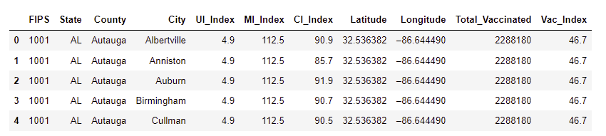
Vaccination - Accuracy
Data preprocessing was performed using Boolean indicators on our outcomes. The majority of our data was already numerical and the outcomes for each index were known due to already having an established threshold.
Vaccination Data Before:

Slide 9
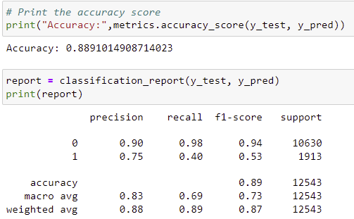
Cost of Living - Accuracy Report
outcome = 0 (no) index is >=10
outcome = 1 (yes) index is <100
Results - Accuracy score of 88.99 (ok!)
Source Code - Cost_of_Living_ML.ipynb

Slide 10
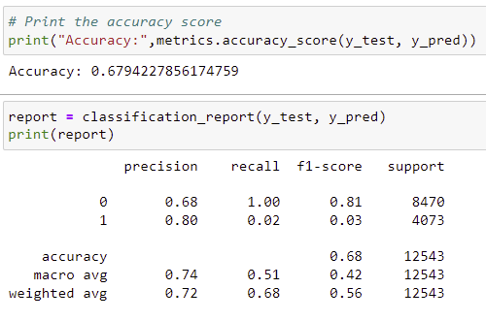
Unemployment - Accuracy Report
outcome = 0 (no) rate is > 6%
outcome = 1 (yes) rate is <= 6%
Results - Accuracy Score 67.94 (sad)
Source code - Unemployment_Index_ML.ipynb

Slide 11
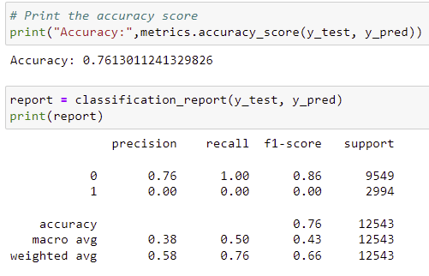
Median Income - Accuracy Report
outcome = 0 (no) index is <100
outcome - 1 (yes) index is >=100
Results - Accuracy Score 76.13% (meh)
Source code - Median_Income_Index_ML.ipynb

Slide 12
Analysis
Logistics regression was the machine learning model of choice.
The model is easy to use and can predict a decision based on the input.
Using datasets from government agencies, we were able to obtain, percentage indexes for the variables. Allowing us to determine good choice vs bad choice.

Slide 13
Analysis (cont.)
Narrow down the list of cities we deem acceptable for living/working so that we have a list of jobs that we can do additional analysis on.
And then determine:
What types of skills are needed?
How well is the company respected
Is it a personal fit?

Slide 14
Dashboard
Using Tableau Public to show all visuals:
Insert csv data into Tableau Public as a text file
Sort and Add filtering to the data from the csv file
Which will create heat maps/bar graph showing job title, location, salary estimate, cost of living, covid and unemployment data.
Saving the maps/graphs as images and adding it to the main branch Resources depository and posting Tableau Public link to ReadMe for access to dashboard.
Link to Dashboard

Slide 15
Recommendation For Future Analysis
Dive Deeper
Take the job descriptions and perform NLP to see what types of commonalities we could find between the different jobs
Look at the companies that we found jobs for and do some additional research on things like CEO, approval ratings, reviews, etc

Slide 16
What would we do different? Challenges
Change the display of results to an interactive webpage
We has some challenges with the size of our datasets and processing the data.
Either finding datasets that were more manageable to work with or possibly using different technology to process the data would help

